Slide 1

DSI Capstone
By DJ Porter
dj@djporter.co

Slide 2
How will the users 'view' or preciecve an article?
Can I predict how an audience will perceive an article?

Slide 3
The problem or challenge
Cryptocurrency is still in its infancy and deemed by many as a 'wild west'.
“I believe that the majority of news that are published is hype and therefore many trading decisions are made due to hype and emotional reasons.”

Slide 4
I plan to predict how the community will perceive the articles that appear on cryptopanic.com
Notes:
I took the perspective of a publisher to help determine drive traffic to a site that publishes articles in the crytpo/blockchain space.

Slide 5

I scraped a list of articles from the site Cryptopanic.com.
The articles were published between:
Feb 8th 2018 - July 9th 2018
Notes:
This site aggregates news, opinions and posts from around the web that pertain to cryptocurrencies and blockchain technologies.
The site sorts them by the coin or coins that the article is related to and allows the users to vote on how they perceive the article.

Slide 6
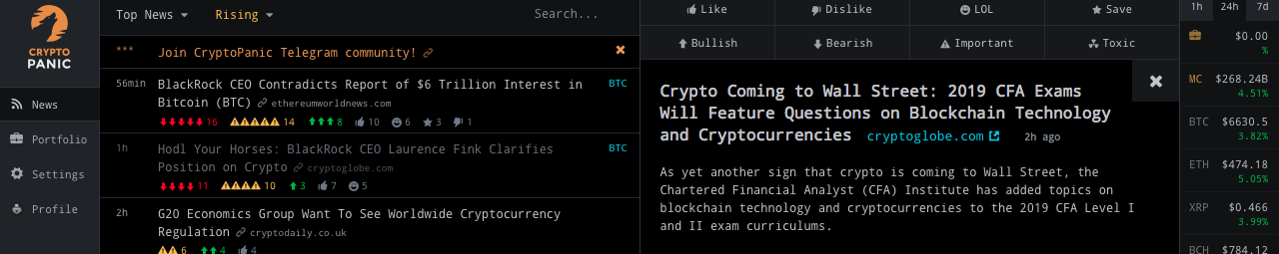
8 voting options
Like v. Dislike
Bullish v. Bearish
Important
Lol
Toxic (pro users only
Saved (bookmark)
Notes:
These options demonstrate a sentiment for the article.
I am making the assumption that article will reach a level of 'maturity' after about a week of being on the site. New articles would have made it to the site and the older ones will likely be ignored and assumed to not be relevant by users. The votes that the article has accumulated will likely not change.
like = The user liked that the article (this assumes that the article is written well and may or may not effect any other features)
dislike = The user did not like the article (this assumes that the article is written well and may or may not effect any other features)
bullish = The user deems that the article to have a bullish impact on the price of the associated currency.
bearish = The user deems that the article to have a bearish impact on the price of the associated currency.
important = The user deems that the article is important in some way.
lol = The user found this article amusing in some way.
toxic = The user found this article to be misleading or contain bad information; SPAM filter. It should be noted that only paying pro members can vote for an article to be toxic.
saved = The user saved the article to view later; A bookmark.

Slide 7
Why Cryptopanic.com
Limitations
Sources
Reddit, Twitter, bitcoin.com, ccn.com, coindesk.com, ethereumworldnews.com, dailyhodl.com, wsj.com and many others. Language Support
English, Deutsch, Español, Italiano, Português, Русский
Does not support Eastern Asian languages...yet.
Cryptopanic does not offer the full text of the article in the API.
I was able to collect 563 individual articles for Bitcoin (BTC).
563
Notes:
Cryptopanic does not offer the full text of the article in the API.
Therefore all analysis on the articles will be completed using the title, description and voting information.
The articles were published between:
Feb 8th 2018 - July 9th 2018

Slide 8
Collect Price Data
I chose to collect hourly pricing data. The data was in the form of:
Open
High
Low
Close
Volume
CryptoCompare.com API
Notes:
Pricing data is available in daily, hourly and minutely increments.
The minute data is only stored for 7 days and for the scope of this project I felt it was too granular.
The daily data would have probably been sufficient however, articles are posted quite often and may have a near immediate effect on price.

Slide 9
Transforming Price Data
I added various indicators using a library called TA-lib, available on Github such as:
RSI (Relative Strength Index) (standard periods, 14 )
SMA (Simple Moving Average) 9, 25, 50, 100 period
Bollinger Bands (standard periods)
Stochastic Strength Indicator (standard periods)
ADX Average Daily Direction (standard periods, 14)
ATR Average True Range (standard periods, 14)
Min Max (Minimum and Maximum price over the last n days (365, 180, 90, 30, 14, 7)
HT_TRENDMODE - Hilbert Transform - Trend vs Cycle Mode
Notes:
Like any asset price is not the only factor. Usually investors will monitor technical indicators in making trading decisions.
Many articles are made in response to either price, and indicator value or an event associated with the coin. The events sometimes come directly from the development group, however other times the event is associated with a problem connected to the coin. In recent times article are in response to a federal authority regulation interest or a hack of an exchange where cryptocurrencies are bought and sold.
Traders respond to technical indicators and news associated with an asset. Therefore I will create columns to reflect indicator values associated with a given coin.

Slide 10
Approach
Define an article as "mature" when it is a week old.
Define that an article can only have a level of bullishness vs bearishness.
Define that all other user voting columns are numerical and will have values from 0 to infinity.

Slide 11
Process
Use TF-IDf to collect a corpus of words from the titles and descriptions of the articles. Remove stop English stop words set maximum features to 2000 per title and description.
Set n grams to a range of (1, -3)

Slide 12
Process (cont).
Build features that measure the readability of the article using two readability scoring methods.
Smog Index (https://en.wikipedia.org/wiki/SMOG)
Coleman Liau Index (https://en.wikipedia.org/wiki/Coleman%E2%80%93Liau_index)
The articles
Notes:
My assumption here is that users will quickly assume the reliability of the article if they can consume it and understand it quickly. More info related to these methods is below. My assumption here is that users will quickly assume the reliability of the article if they can consume it and understand it quickly. More info related to these methods is below.

Slide 13
Process (cont).
Use textblob to build features for checking polarity and subjectivity of the title and description.
polarity has a range of (-1, 1)
subjectivity has a range of (0, 1)
Text Sentiment
Notes:
My assumption here is that users will quickly assume the reliability of the article if they can consume it and understand it quickly. More info related to these methods is below. My assumption here is that users will quickly assume the reliability of the article if they can consume it and understand it quickly. More info related to these methods is below.

Slide 14
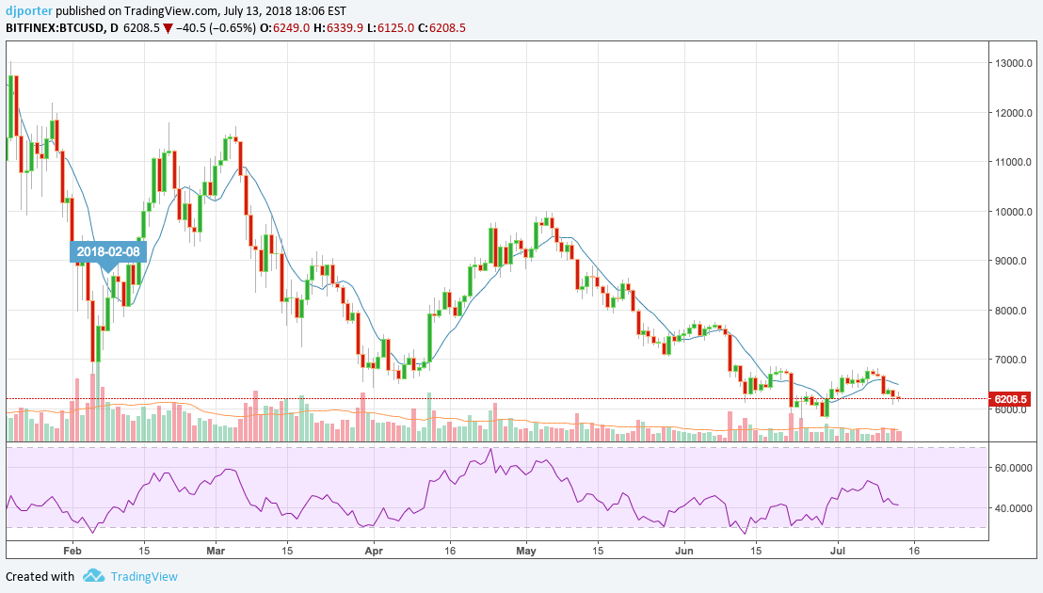
During the period that the articles are from, Bitcoin was in a steady decline in price, with some Bullish days.

Slide 15
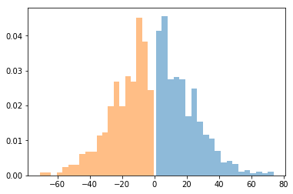
A look at the data.
Bullish vs Bearish
User generated votes were usually neutral
Likely due to most articles being ignored.

Slide 16
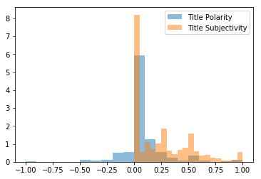
A look at the data. (cont.)
The title polarity didn’t necessarily match the subjectivity.
But they were each heavily skewed.

Slide 17
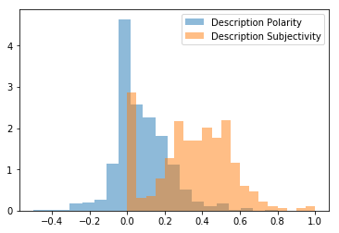
A look at the data. (cont.)
Like the Title
The description polarity didn’t necessarily match the subjectivity.
Unlike the title
They were each distributed differently.

Slide 18
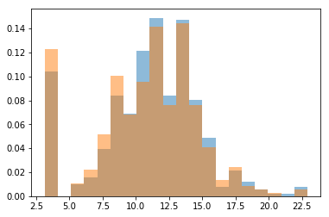
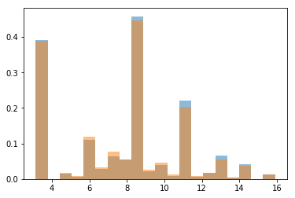
Smog Score (a measure of readability)
Description
Title

Slide 19
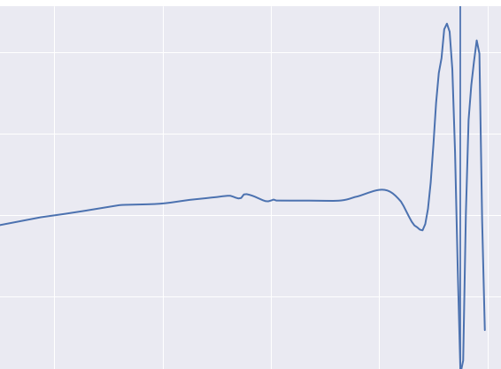
Modeling
I used an Elastic Net to predict on user generated sentiment.
I varied the alphas to optimize regularization.
Each target has different parameters.
This model was very conservative in its predictions

Slide 20
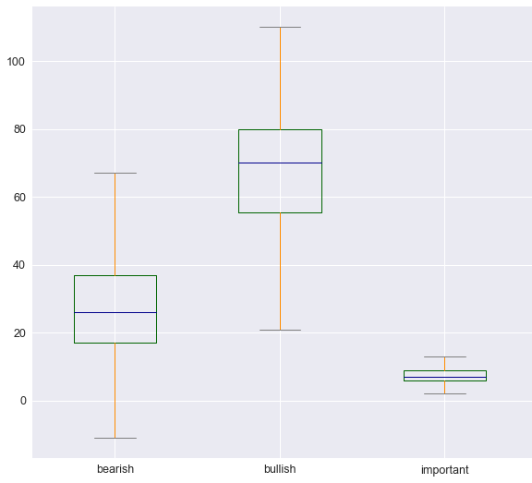
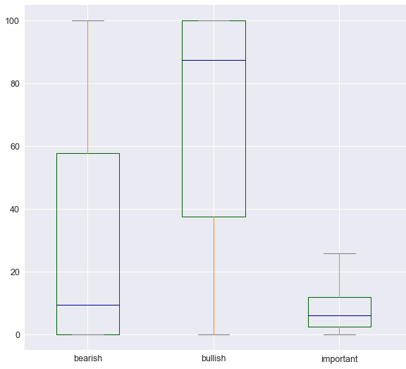
Results of the Elastic Net Model
Predictions
Actuals
Notes:
This was an unrealistically long process.
Only was able to converge on the bullish, bearish and important voting features.
You can see here that compared to the actuals, tte predictions are much more conservative.
Ok for a publisher to get a sense of the articles expected perception on cryptopanic

Slide 21

More Modeling
Using a Random Forest Classifier to predict on Bullish votes.
Notes:
Chose for interpretability

Slide 22
Results of the Random Forest Classifier
78.6%
Precision show that when the Random Forest Classifier identified an article as Bullish it was Bullish 78.6% of the time.
Recall shows that of all of the bullish articles 88.0% where identified by the Random Forest Classifier.
Accuracy show that of all the articles the Random Forest Classifier predicted them to be bullish correctly 76.0% of the time.
88.0%
76.0%
Notes:
Precision show that when the Random Forest Classifier identified an article as Bullish it was Bullish 78.6% of the time.
Recall shows that of all of the bullish articles 88.0% where identified by the Random Forest Classifier.
Accuracy show that of all the articles the Random Forest Classifier predicted them to be bullish correctly 76.0% of the time.

Slide 23
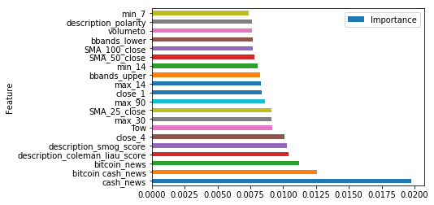
Important Features

Slide 24
Explanation of Important Features
The words Bitcoin and Bitcoin Cash are coming from words used in the title or description of the article.
Many other features refer to price history and activity at the time of the article.
Close_1, close_4 refers to the price n hours ago.
Min_7, min_14 refers to the minimum price Bitcoin has reached in the last n days.
Max_30, max_90 refers to the maximum price Bitcoin has reached in the last n days.
SMA_25_close, SMA_50_close, SMA_100_close refers to the Simple Moving Average on the close price over a period of n days.
Notes:
The words Bitcoin and Bitcoin Cash are coming from words used in the title or description of the article.
Many other features refer to price history and activity at the time of the article.
Close_1, close_4 refers to the price n hours ago.
Min_7, min_14 refers to the minimum price Bitcoin has reached in the last n days.
Max_30, max_90 refers to the maximum price Bitcoin has reached in the last n days.
SMA_25_close, SMA_50_close, SMA_100_close refers to the Simple Moving Average on the close price over a period of n days.

Slide 25
Explanation of Important Features
All other features refer to other price history details.
Or the:
coleman_liau_score, smog_score refer to readability of the article.
This is expected because people are perceptive and they can determine if an article is worth reading quickly.
Notes:
All other features refer to other price history details.
Or the:
coleman_liau_score, smog_score refer to readability of the article.
This is expected because people are perceptive and they can determine if an article is worth reading quickly.

Slide 26
Missing
... but expected
Important Features
Sentiment factors did not appear in the important features list.
Polarity and Subjectivity were measured on titles and descriptions.
Notes:
Sentiment factors did not appear in the important features list.
Polarity and Subjectivity were measured on the Titles and Descriptions.
This could be due to:
Other overwhelming features
Sentiment could be explained by other technical analysis features.

Slide 27
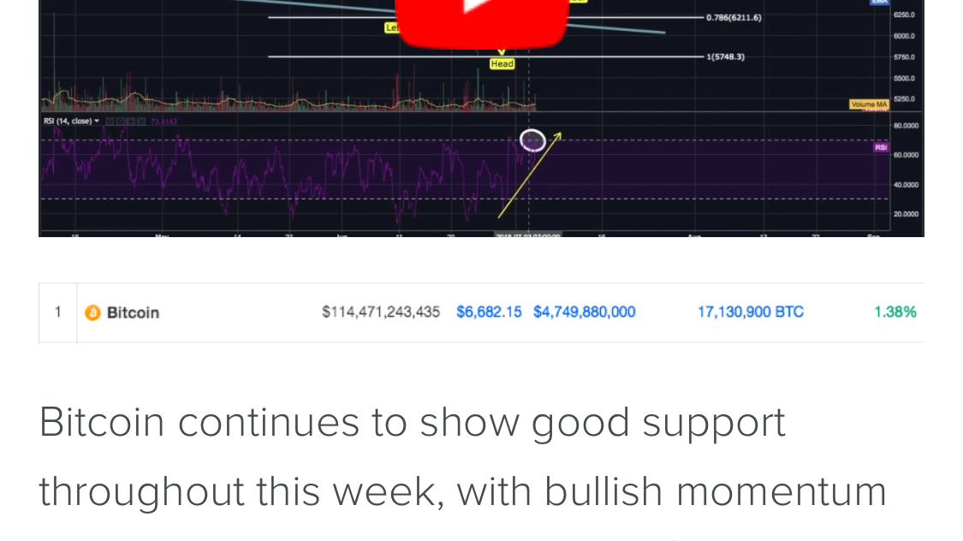
Many article are likely written in response to or in hopes of a technical analysis event.
Notes:
A technical writer may see an opportunity to write an article in the analysis of an asset. So it is written...

Slide 28
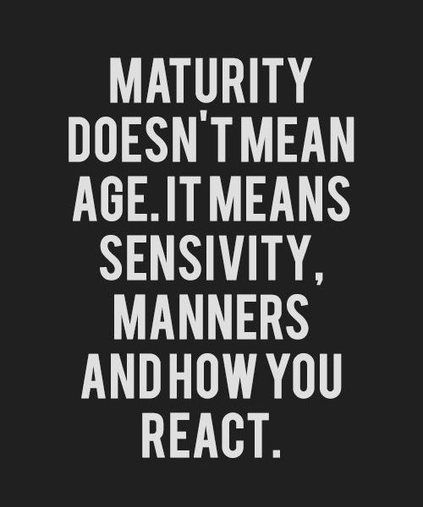
My conclusion...
Remember my hypothesis:
“I believe that the majority of news that is published is hype and therefore many trading decisions are made due to hype and emotional reasons.”
The data shows that the technical analysis of the underlying asset is a major factor in the article voting.
These two parts however could be more intertwined than the data shows.
Cryptopanic may actually have a pretty good spam filter built in, thus eliminating toxic or misleading articles.
These are signs of a maturing market and community.
Notes:
Remember my hypothesis:
“I believe that the majority of news that is published is hype and therefore many trading decisions are made due to hype and emotional reasons.”
The data shows that the technical analysis of the underlying asset is a major factor in the article voting.
These two parts however could be more intertwined than the data shows.
Cryptopanic may actually have a pretty good spam filter built in, thus eliminating toxic or misleading articles.
These are signs of a maturing market and community.

Slide 29
Looking Forward and Next Steps
Reproduce from a different and longer time frame.
Collect more data.
The short timeframe of about 4 months may not accurately represent data from the Crypto community.
Collect the article body to get a more complete picture of what the article is saying.
The votes and articles were collected at random times.
Collect incremental snapshots of the article votes. To get a more accurate representation of users interest in the article.
Consider collecting data from announcement boards.
Do this on a GPU. My MacBook Pro is not handling this very well.
Notes:
Reproduce from a different and longer time frame.
Collect more data.
The short timeframe of about 4 months may not accurately represent data from the Crypto community.
Collect the article body to get a more complete picture of what the article is saying.
The votes and articles were collected at random times.
Collect incremental snapshots of the article votes. To get a more accurate representation of users interest in the article.
Consider collecting data from announcement boards.
Do this on a GPU. My MacBook Pro is not handling this very well.

